Slide 1
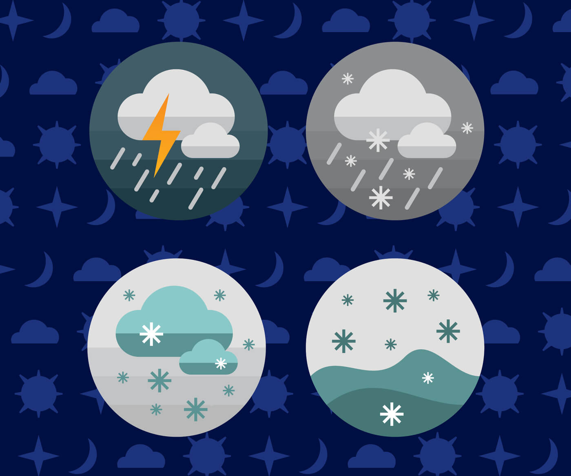
CLIMATE READER

Slide 2


TEAM MEMBERS
ROHITH
SRILEKHA
LASYA SREE
TEJA
SAMPATH
RAJINI

Slide 3
Table of content
INTRODUCTION
SCOPE AND PURPOSE
REQUIREMENTS
ADDITIONAL INFORMATION

Slide 4
INTRODUCTION
Weather report application is a web based application through which you will able to get all the reports related to weather forecasting of any locations.
Its geographical locator which will be received through your browser setting and server configuration will automatically identify the location and able to present its weather details such as temperature, direction of wind, rains, humidity etc.
To change the location you will just have to select the options provided below to get its details. Its new avatars and feed burner will also allow its users to get the weather reports directly to their mail, when they were not able to access this particular domain or even when the server is down.
Its weather watch gadgets in animated form will able to notify about weather for particular date and time also.

Slide 5
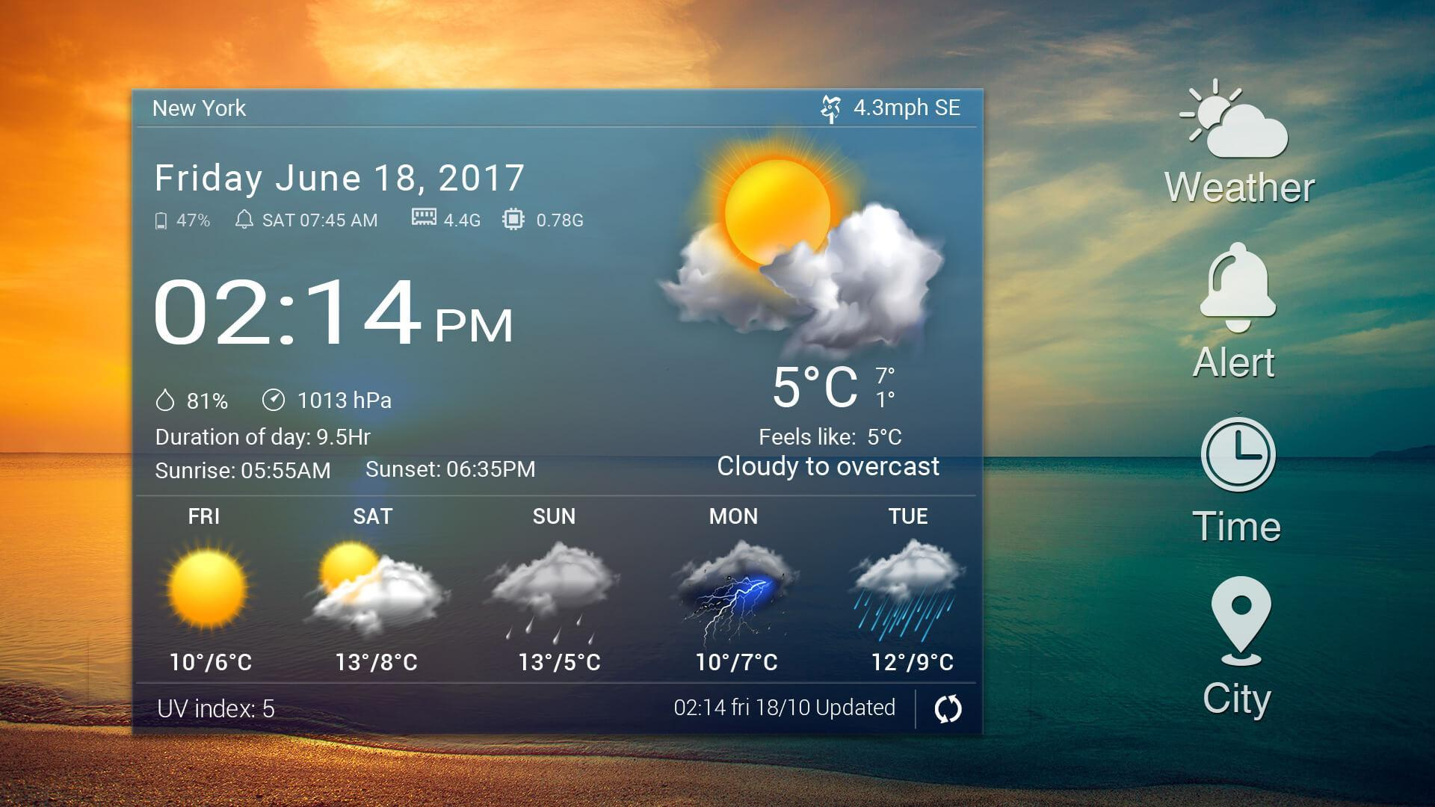
SCOPE AND PURPOSE
1.It tells us how much wind speed we can expect and condition of temperature
2.There are several reasons by weather forecast are important.
3.It is a product of science that impacts live of people.
4.Helps people plan outdoor activities.
5.Helps farmers and gardeners plan for crop irrigational and protection.

Slide 6

PLATFORM REQUIREMENTS
FRONT END : HTML, CSS, JAVA SCRIPT
BACK END : JAVA SPRING Boot , ORACLE DATABASE.

Slide 7
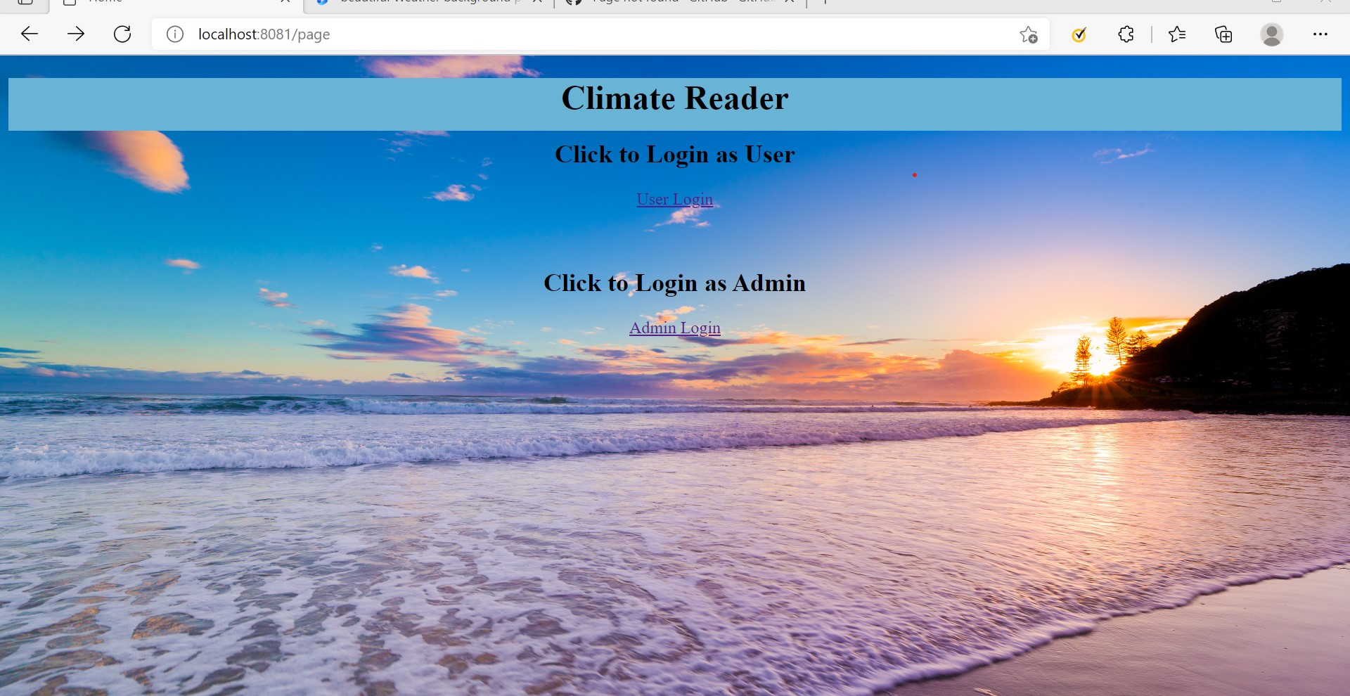
This is the Home Page of Climate Reader it has User and Admin login Links.

Slide 8
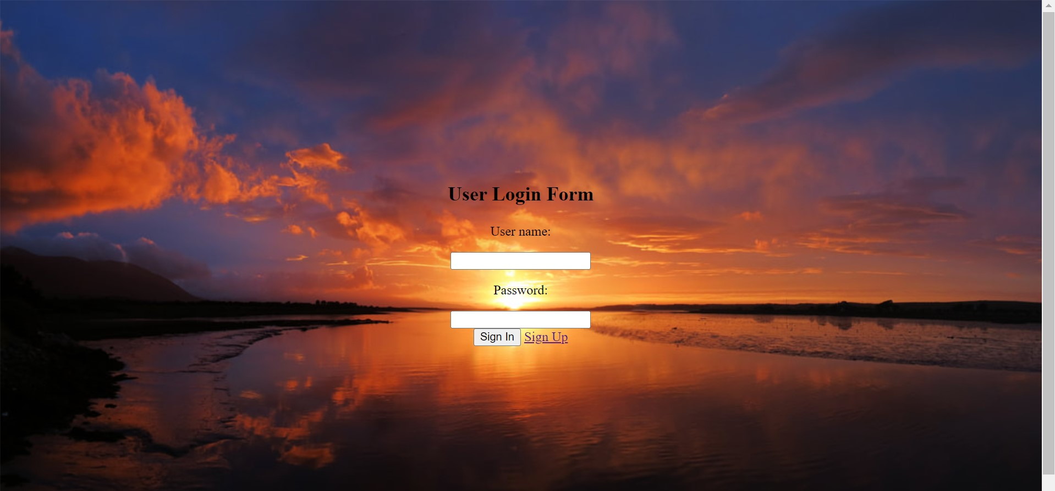
After we click user login link we get ‘user login form’

Slide 9
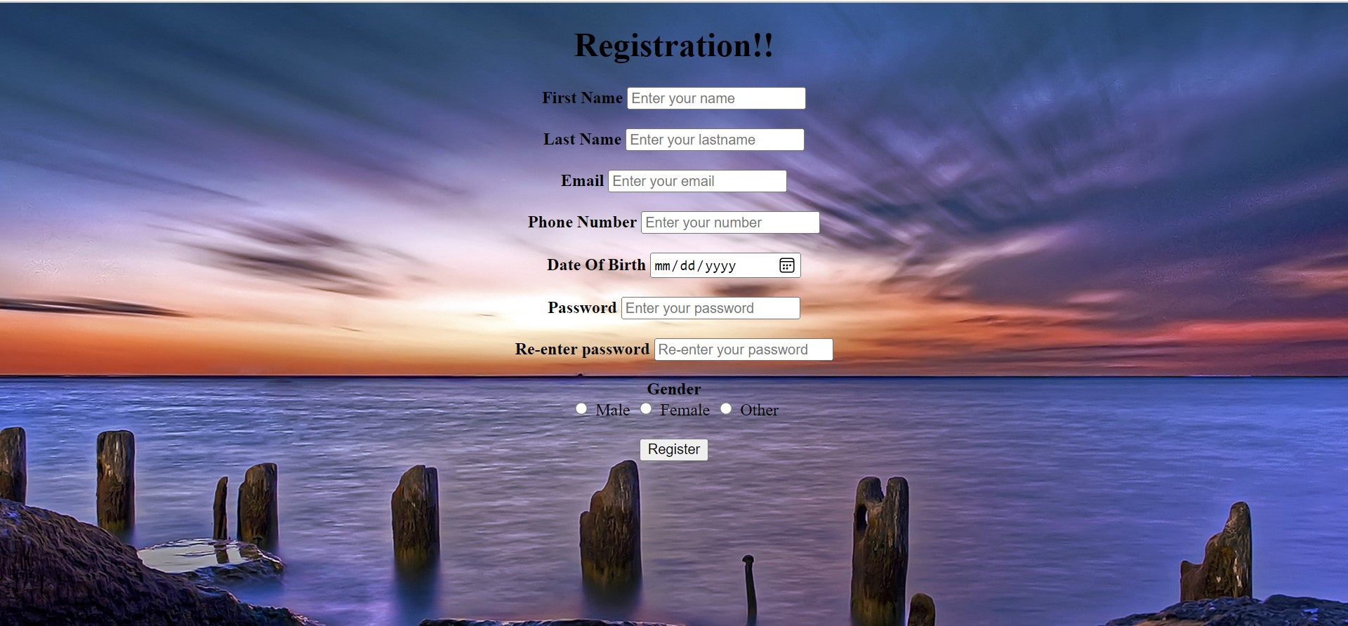
If we click the “Sign Up” Link in login form, we will get the User’s Registration Page.

Slide 10
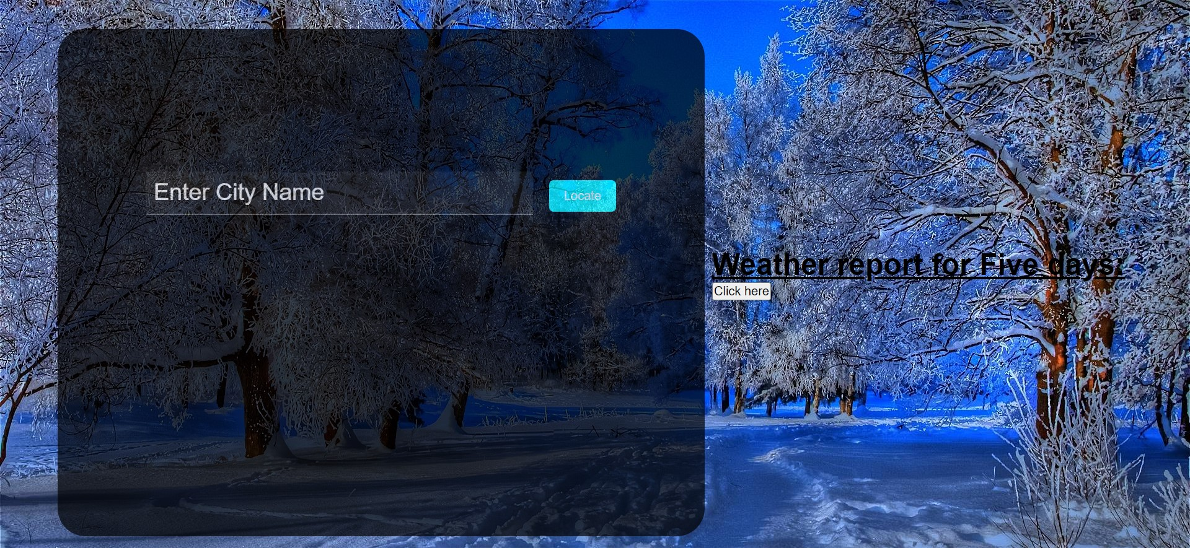
This is Weather Report if we login successfully Here We can see weather report of Today’s and following Five days Link.

Slide 11
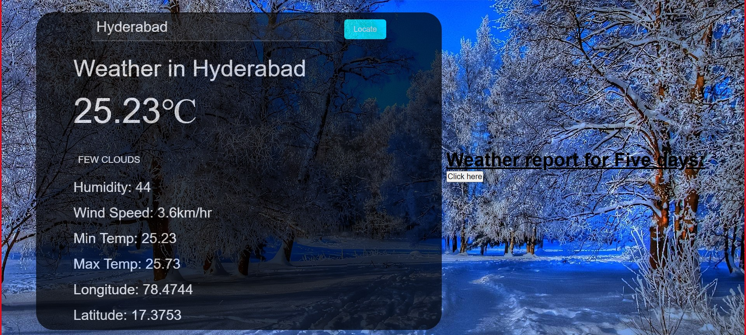
Here we have given City has Hyderabad and we clicked Locate. All the details temp, Weather, Description, Wind Speed, Minimum and Maximum temperature, Longitude and Latitude of Appeared.

Slide 12
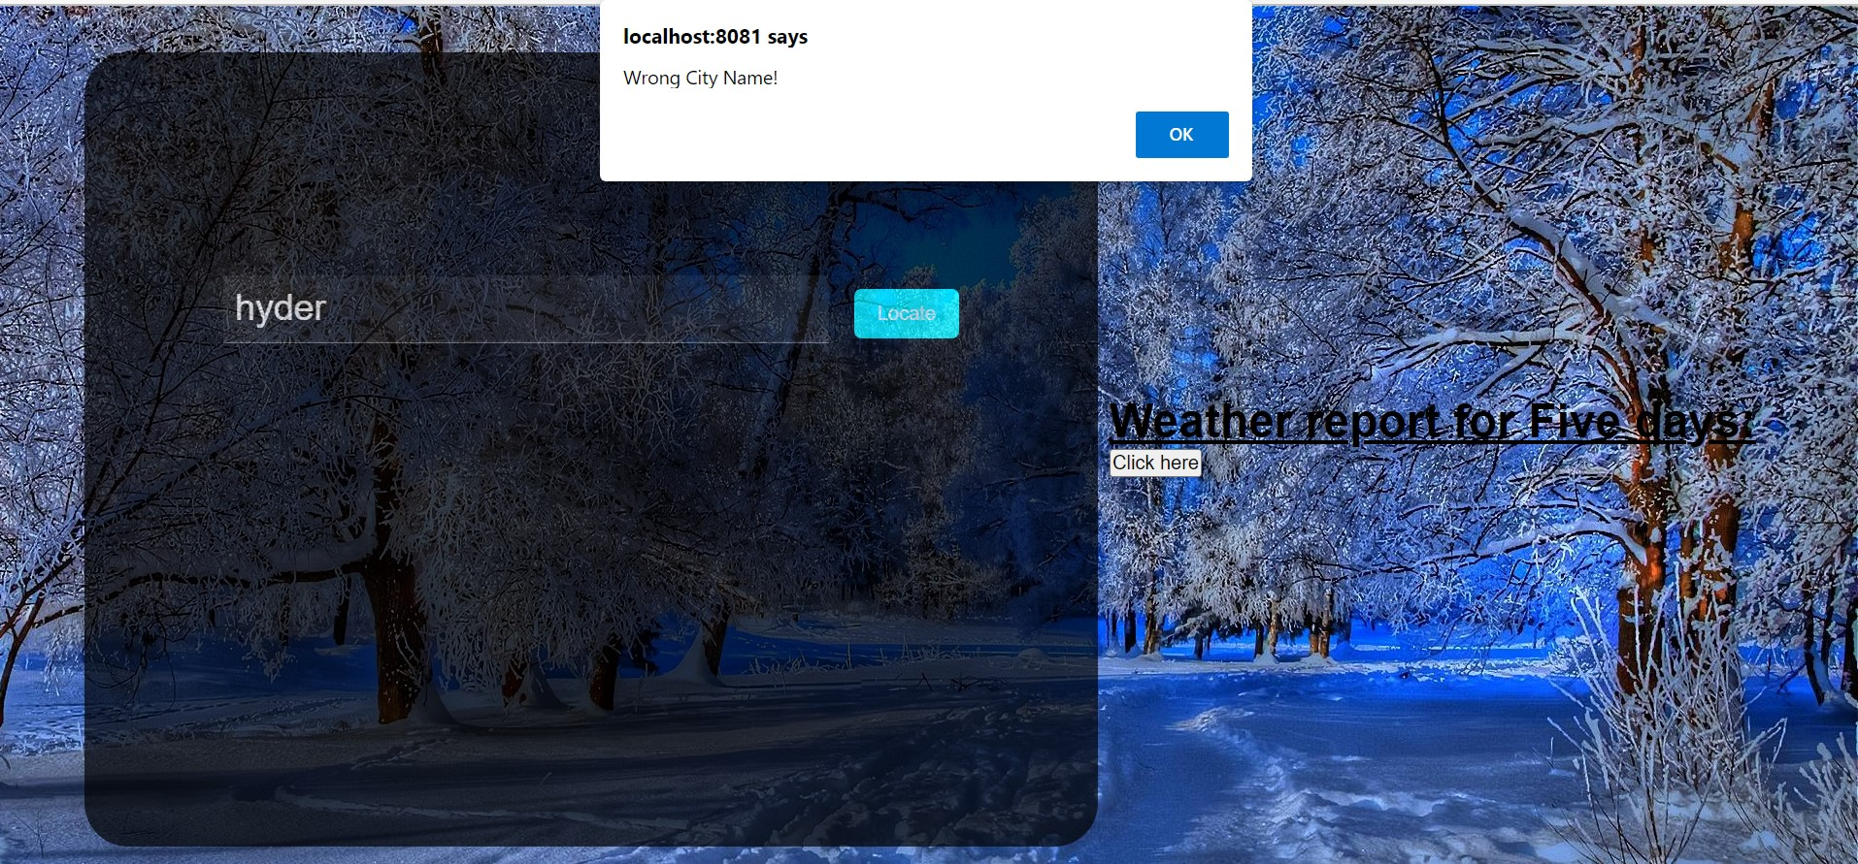
If we enter wrong city name, It will show a notification as ‘Wrong city Name’.

Slide 13
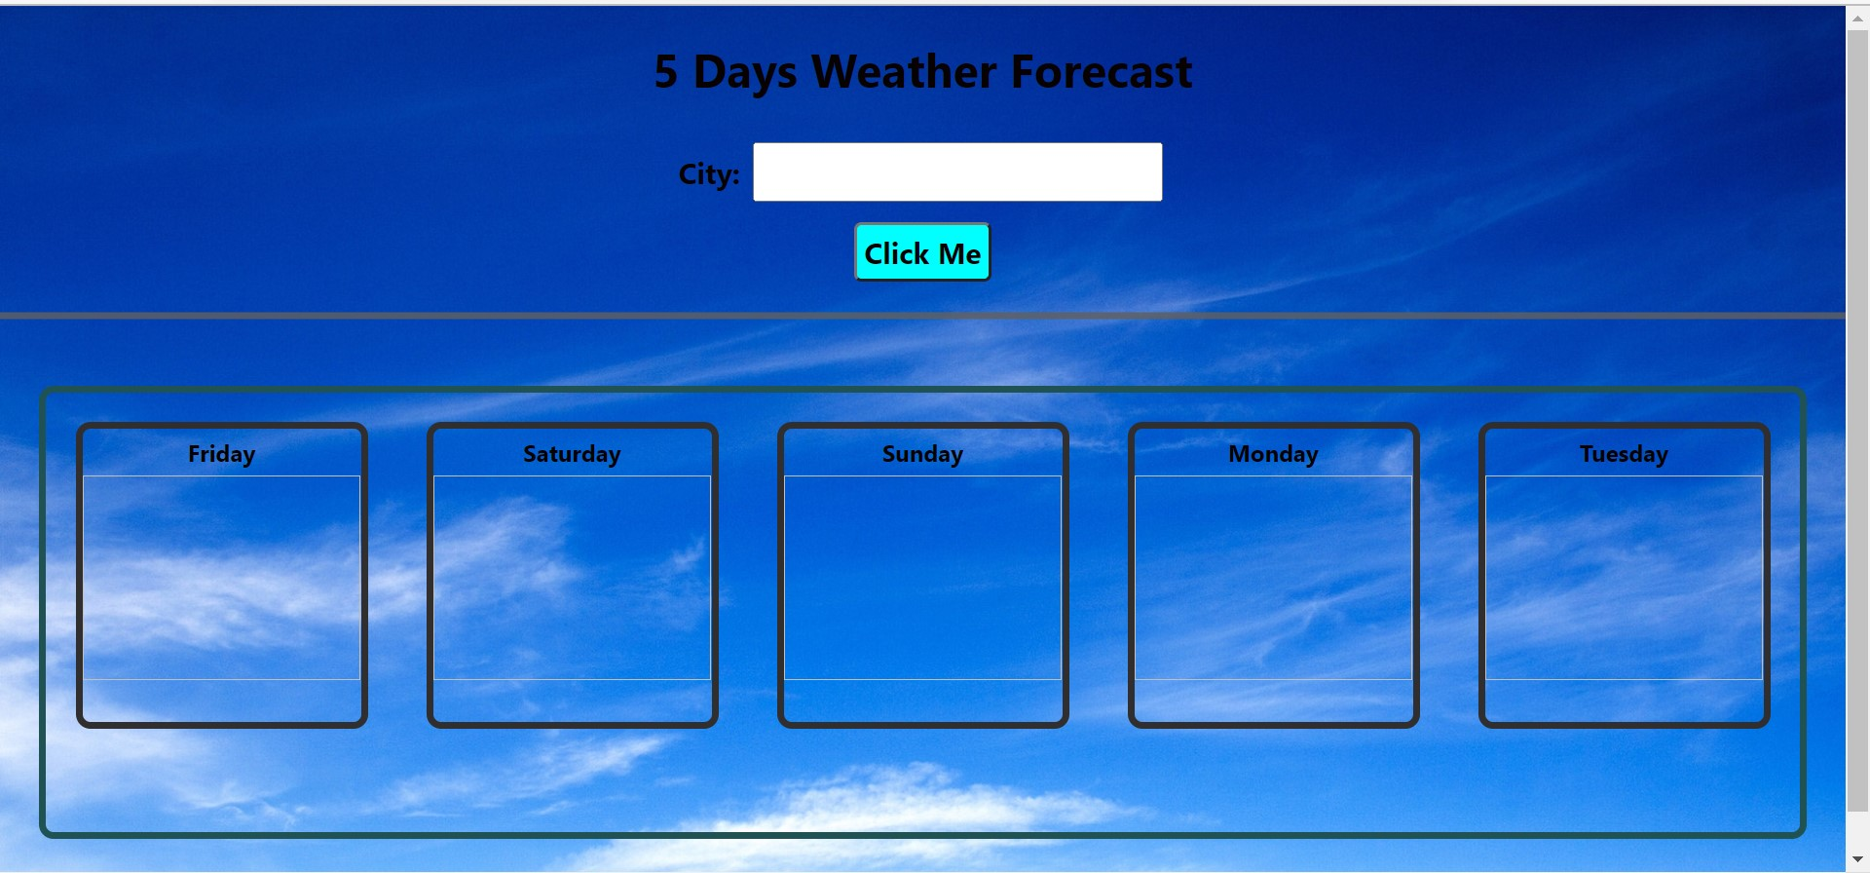
When I clicked 5 Days Weather Forecast Link this page will open.

Slide 14
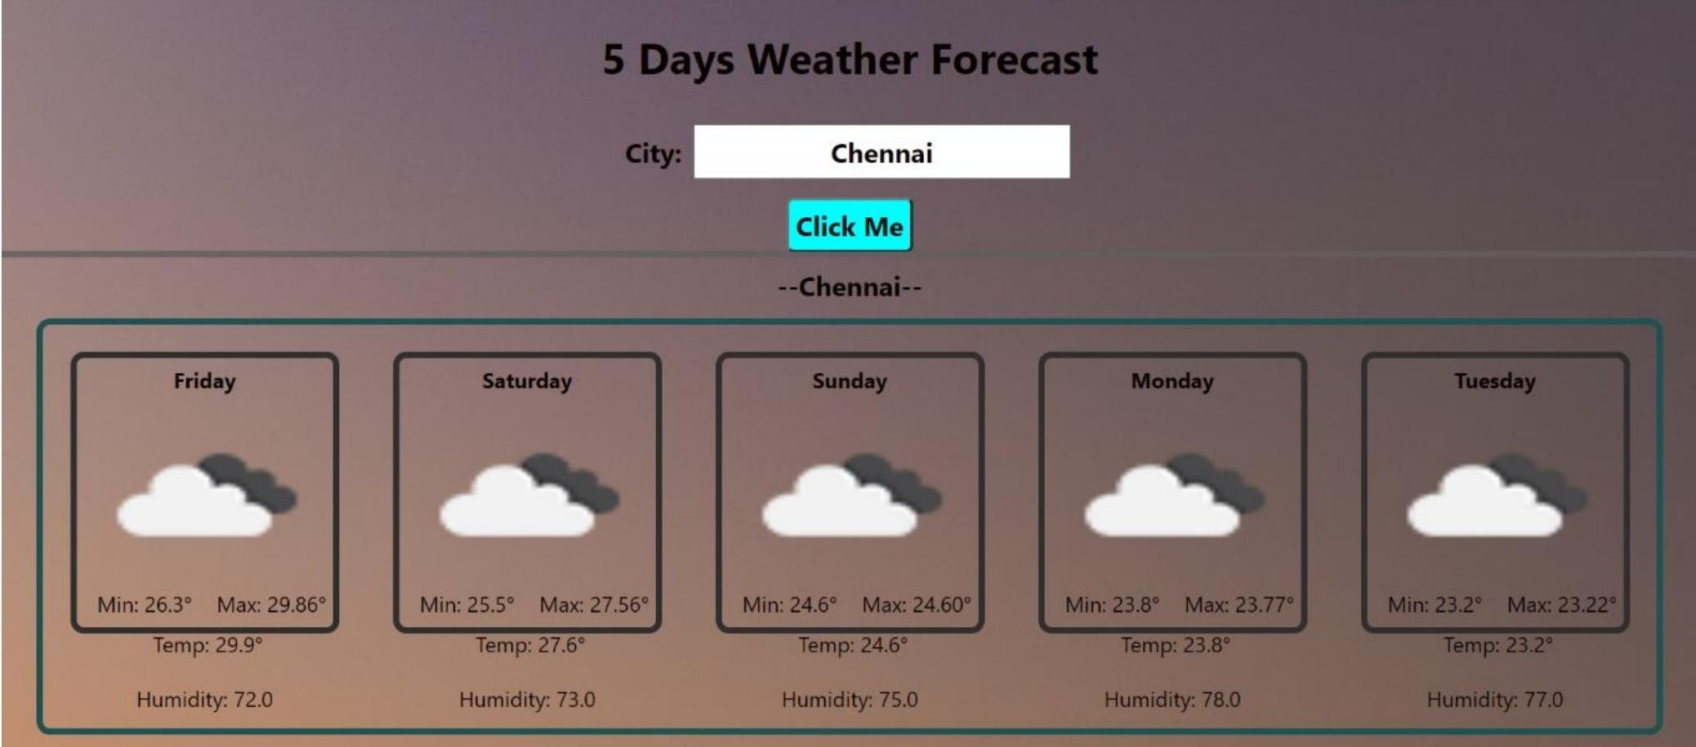
When we give City name as Chennai and clicked “click me” button then we get Min and Max temperature and humidity for 5 days along with present day.

Slide 15
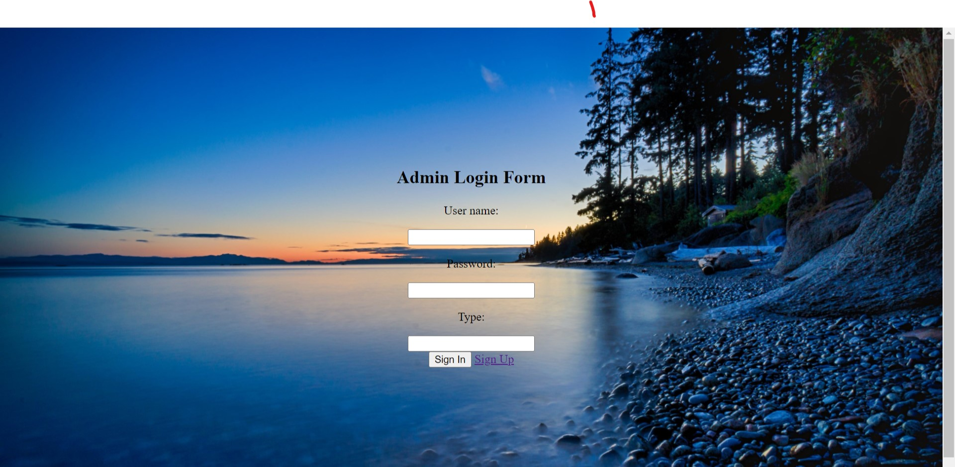
If we click Admin link in Home Page. This Admin Login page will open.

Slide 16
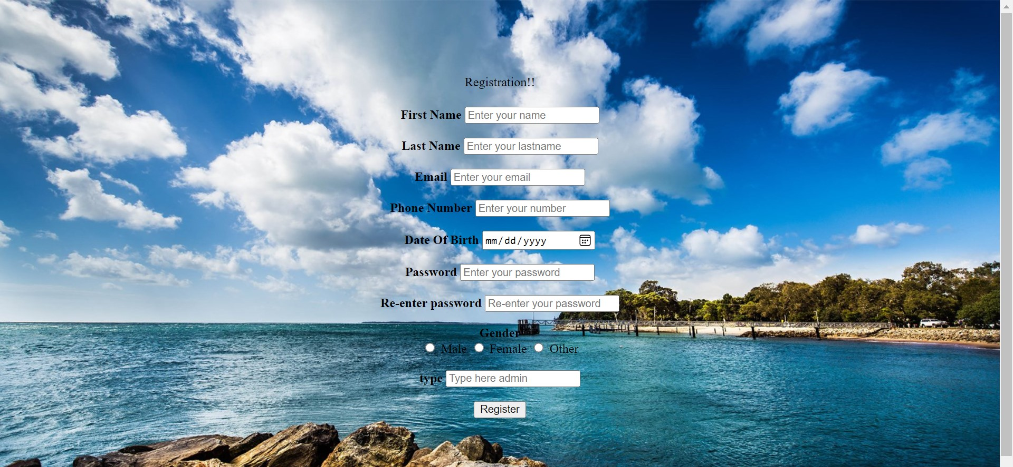
Admin Registration Page.

Slide 17
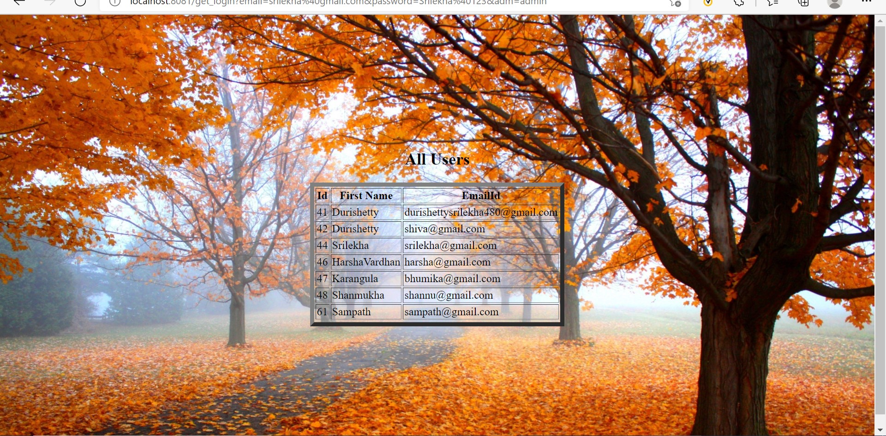
If we Login successfully as Admin we will get all the details of Users who login.

Slide 18
conclusion
This is mainly useful for business people and tourists.
Weather forecasters often discuss the models they use to help predict the weather.
The prediction of the state of the atmosphere for a given location using the application of science and technology.
weather forecasts are increasingly accurate and useful, and their benefits extend widely across the economy.
Weather warnings are a special kind of shortrange forecast carried out for the protection of human life.

